Slide 1
Department of Computer Engineering Institute of Engineering & Technology Devi Ahilya Vishwavidyalaya, Indore (M.P.) GUIDED BY:- SUBMITTED BY:- Mr. Amit Mittal Sir Akanshi Jain (18C7008) Jatin Sadhwani (19C7082) Sanil Sarathe (19C7086)
Solar power forecasting

Slide 2
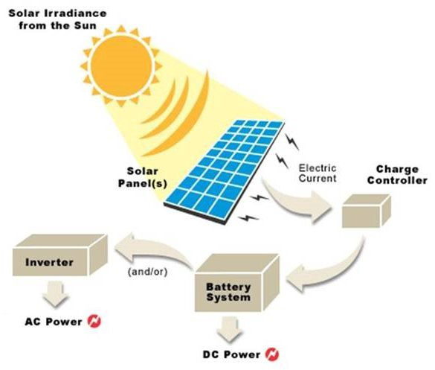
1. Problem Domain 2. Literature Survey 3. Solution Domain 4. Use Case Diagram 5. Model Deployment 6. Learnings From The Project
CONTENTS :-

Slide 3
Problem Domain
→ In recent years, the rapid boost of variable energy generations particularly from wind and solar energy resources in the power grid has led to these generations becoming a noteworthy source of uncertainty with load behaviour still being the main source of variability.
→ Solar power is the conversion of energy from sunlight into electricity, either directly using photovoltaics (PV), or indirectly using concentrated solar power systems. → The main crucial and challenging issue in solar power production is the intermittency of power generation due to weather conditions. In particular, a variation of the temperature and irradiance can have a profound impact on the quality of electric power production. → Solar power forecasting basically is predicting the solar generation for future time blocks based on forecasted weather parameters like irradiance, ambient temperature, humidity, wind speed and other relevant parameters.

Slide 4
→ PV power generation is dependent on many factors, such as weather conditions and PV module temperature. Natural variation in climatic conditions can vary these factors changing the PV power generation. Since PV power generation is variable, intermittent, and nonlinear, an accurate solar power forecasting method is required to operate the power system reliably and stably and to ensure quality power production. → In this section, we provide information about the state of the art literature in the research field and we point out the main advantages that our proposal can provide to the research community many solar energy models have been proposed in the literature using different techniques and approaches. For instance, linear mathematical functions have been used on different project as in Algeria, with satellite data, in sparse regions or in Malaysia.
Literature survey

Slide 5
→ On the other hand, non-linear functions have been used for calculating daily diffuse solar radiation, irradiation models and they have been combined with angstrom coefficients in quadratic models and unrestricted methods if we focus on fuzzy logic approach, it has been used with meteorological parameters and for short-term energy forecasting. Finally, we can find genetic algorithms used in order to achieve the self-sustainability of a pump and finally, the use of artificial neural networks (ANN).

Slide 6
Exploratory Data Analysis There are some steps to perform EDA are : 1. Check For Missing Data 2. Identify Shape Of The Data 3. Identify The Outlier 4. Dimensionality Reduction Data Pre-processing Data pre-processing is a process of preparing the raw data and making it suitable for a machine learning model. It is the first and crucial step while creating a machine learning model.

Slide 7
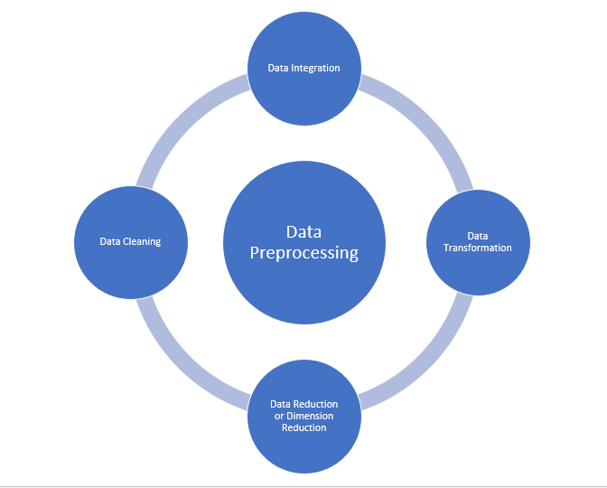
Major Tasks in Data Pre-processing: 1. Data cleaning → Handling missing values → Noisy :- → Regression → Clustering 2. Data integration 3. Data reduction

Slide 8
4. Data transformation - Smoothing - Aggregation - Normalization Model Training :- The process of training an ML model involves providing an ML algorithm (that is, the learning algorithm) with training data to learn from. The term ML model refers to the model artifact that is created by the training process.

Slide 9
Model Evaluation
There are three error metrics that are commonly used for evaluating and reporting the performance of a regression model; they are: mean squared error (MSE). Root mean squared error (RMSE). Mean absolute error (MAE) →Mean Squared Error(MSE) →Root Mean Squared Error(RMSE) →Mean Absolute Error(MAE)
Hyperparameter Tuning
Models can have many hyperparameters and finding the best combination of parameters can be treated as a search problem. Two best strategies for hyper parameter tuning are:
1. Grid search cv 2. Randomized search cv

Slide 10
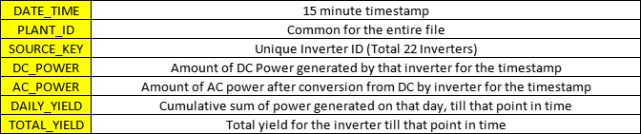
This data has been gathered at solar power plants in India over a 34 day period. 1. Solar Power Generation Data set : The power generation datasets are gathered at the inverter level - each inverter has multiple lines of solar panels attached to it. 2. Solar Power Weather Sensor Data set : The sensor data is gathered at a plant level - single array of sensors optimally placed at the plant.
Solution Domain

Slide 11
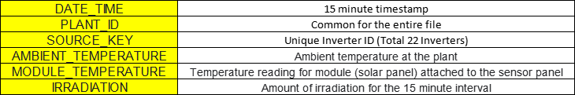
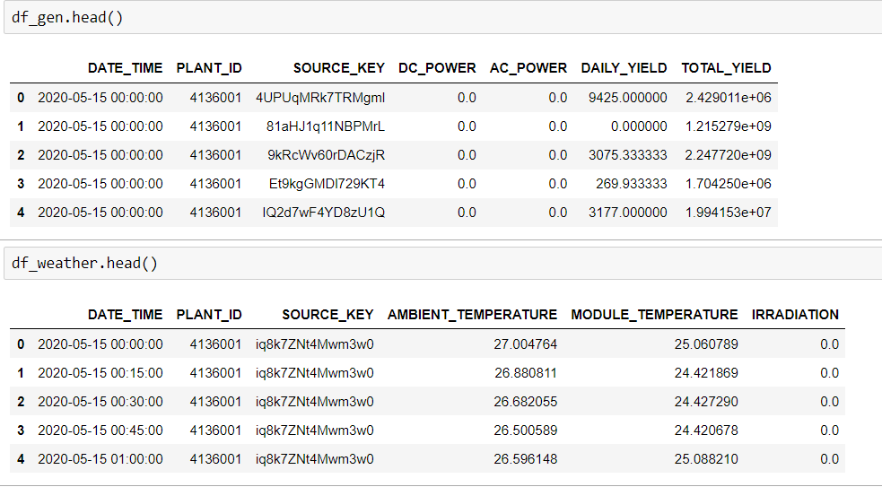
→ Power Generation and Weather dataset

Slide 12
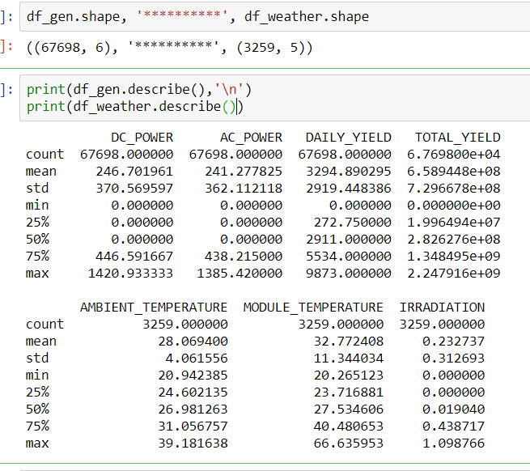
Perform EDA on both dataset. EDA contains some steps like identify missing values, data description, identify outliers, identify shape of dataset, visualize dataset, etc.

Slide 13
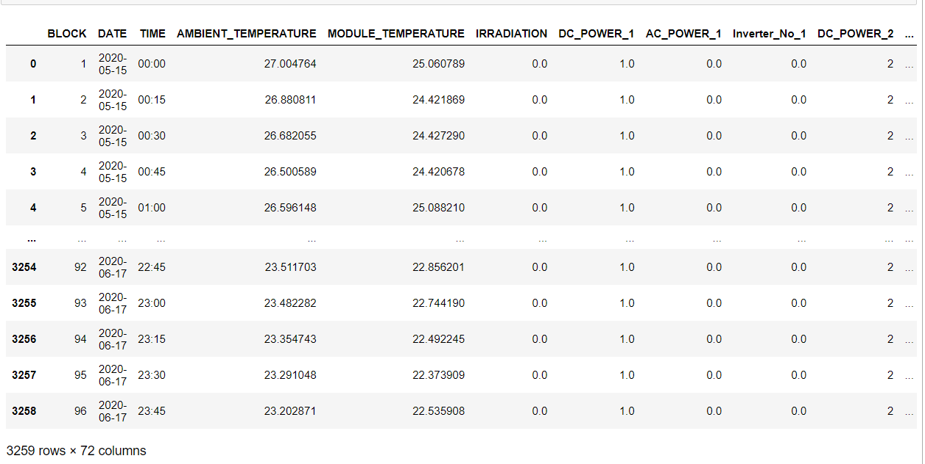
Then we do a data preprocessing like: → we had rows based on each inverter i.e. each timestamp is being repeated the number of inverters for which data is present for that particular time stamp(e.g. suppose for 1st timestamp, only 12 inverters’ data is present so it will show 12 rows for that single time-stamp. → Merge both the datasets and Extract date and time from the date_time feature, and created a new column named “BLOCK”. Each time block representing a 15 min interval. So each day have 96 time block from 00:00 as 1st to 23:45 as 96th

Slide 14

Split the dataset into the training and testing. Instead of going for random splitting, we will select the last 3 days for testing and rest as for training for the sake of continuity which will help in our imputation.

Slide 15
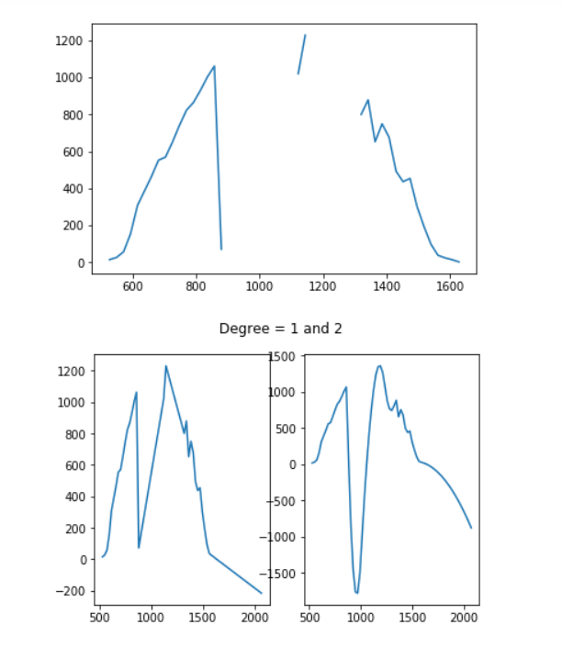
→ Now we try to handle the missing values. Most of values (90%) are null because of no power generation like from ( 00:00 to 06:00 and 18:00 to 24:00 ). Because these time intervals can’t generate the power. So we fill the missing values of these time intervals is 0. → Power will be generated from the 06:00 to 18:00. So, we filled missing values of these time interval using the interpolate method.

Slide 16
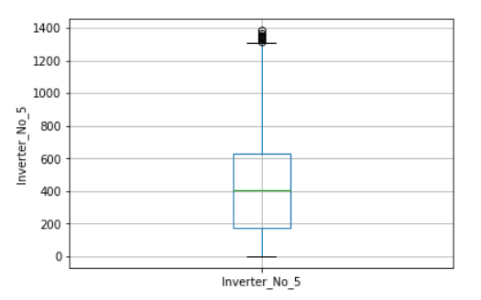
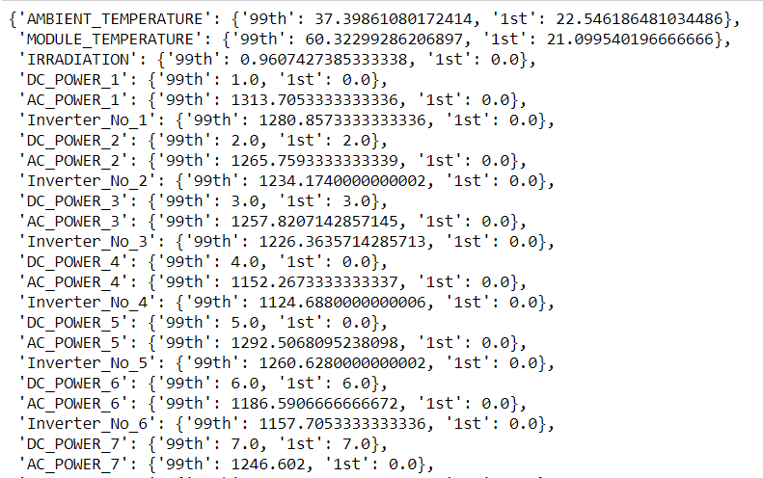
Then we try to handle the outliers from the training and testing set using the percentile. Boxplot summarizes sample data using 25th, 50th, and 75th percentiles. One can just get insights(quartiles, median, and outliers) into the dataset by just looking at its boxplot.

Slide 17
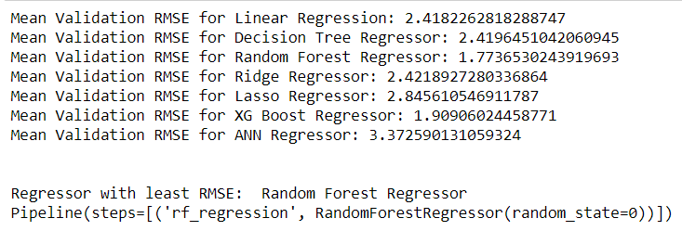
→ With the help of Scikit learn’s beautiful ‘Pipeline’ functionality to wrap different models for the ease of training, we have used here 7 different Regression algorithms with default parameters including a 3 layered Artificial Neural Network regressor. → Then we evaluate the model. For Regression problems, generally we use: Mean Absolute Error(MAE), Mean Squared Error(MSE) and Root Mean Squared Error(RMSE). We’ll be choosing RMSE over MAE and MSE. Because RMSE penalize the bigger errors into the small ones, So we select RFR based on the less RMSE score. → Then we Fine-Tune the RFR model using the hyper parameter tuning.

Slide 18
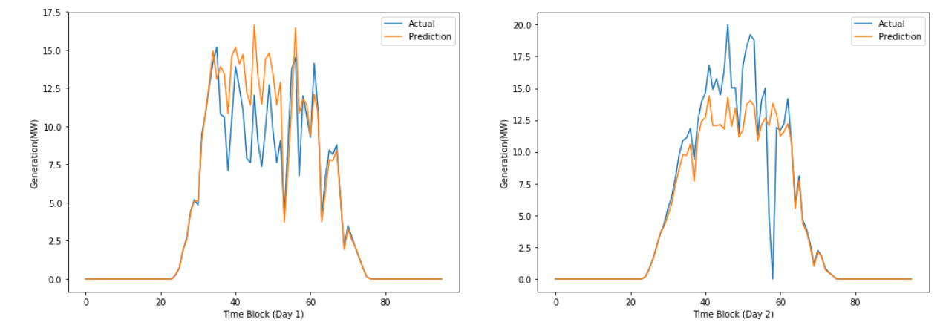
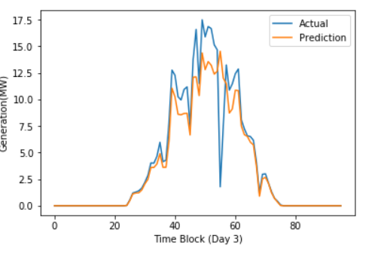
→ Now it’s time to test the model, we test the model on testing dataset (Try to forecast next 3 days). Then our model forecast the 3 days. As you can see the below outcome (Actual and Forecast Prediction).

Slide 19
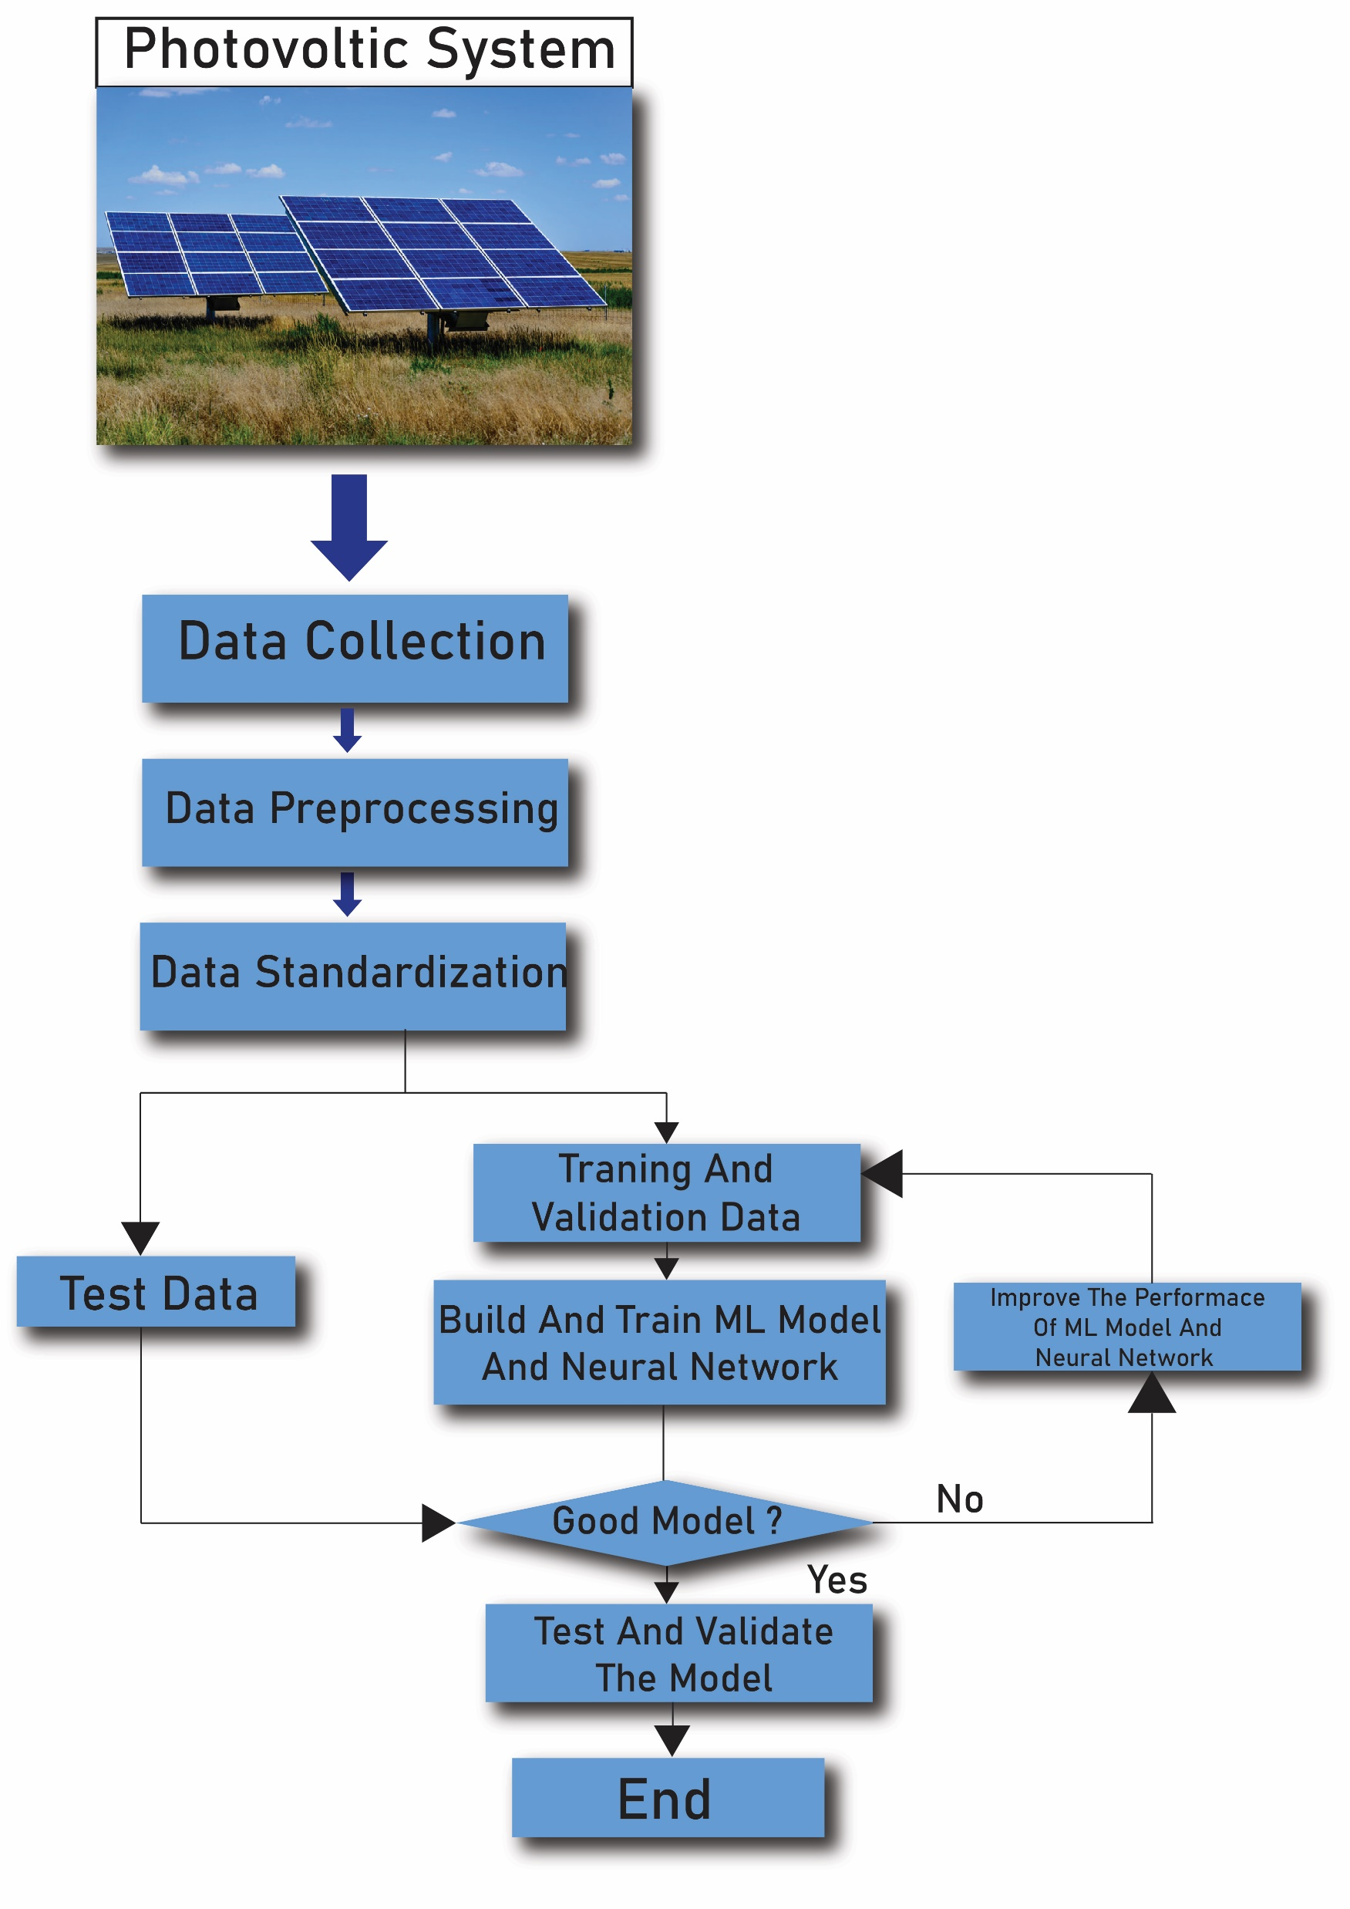
Use case diagram

Slide 20
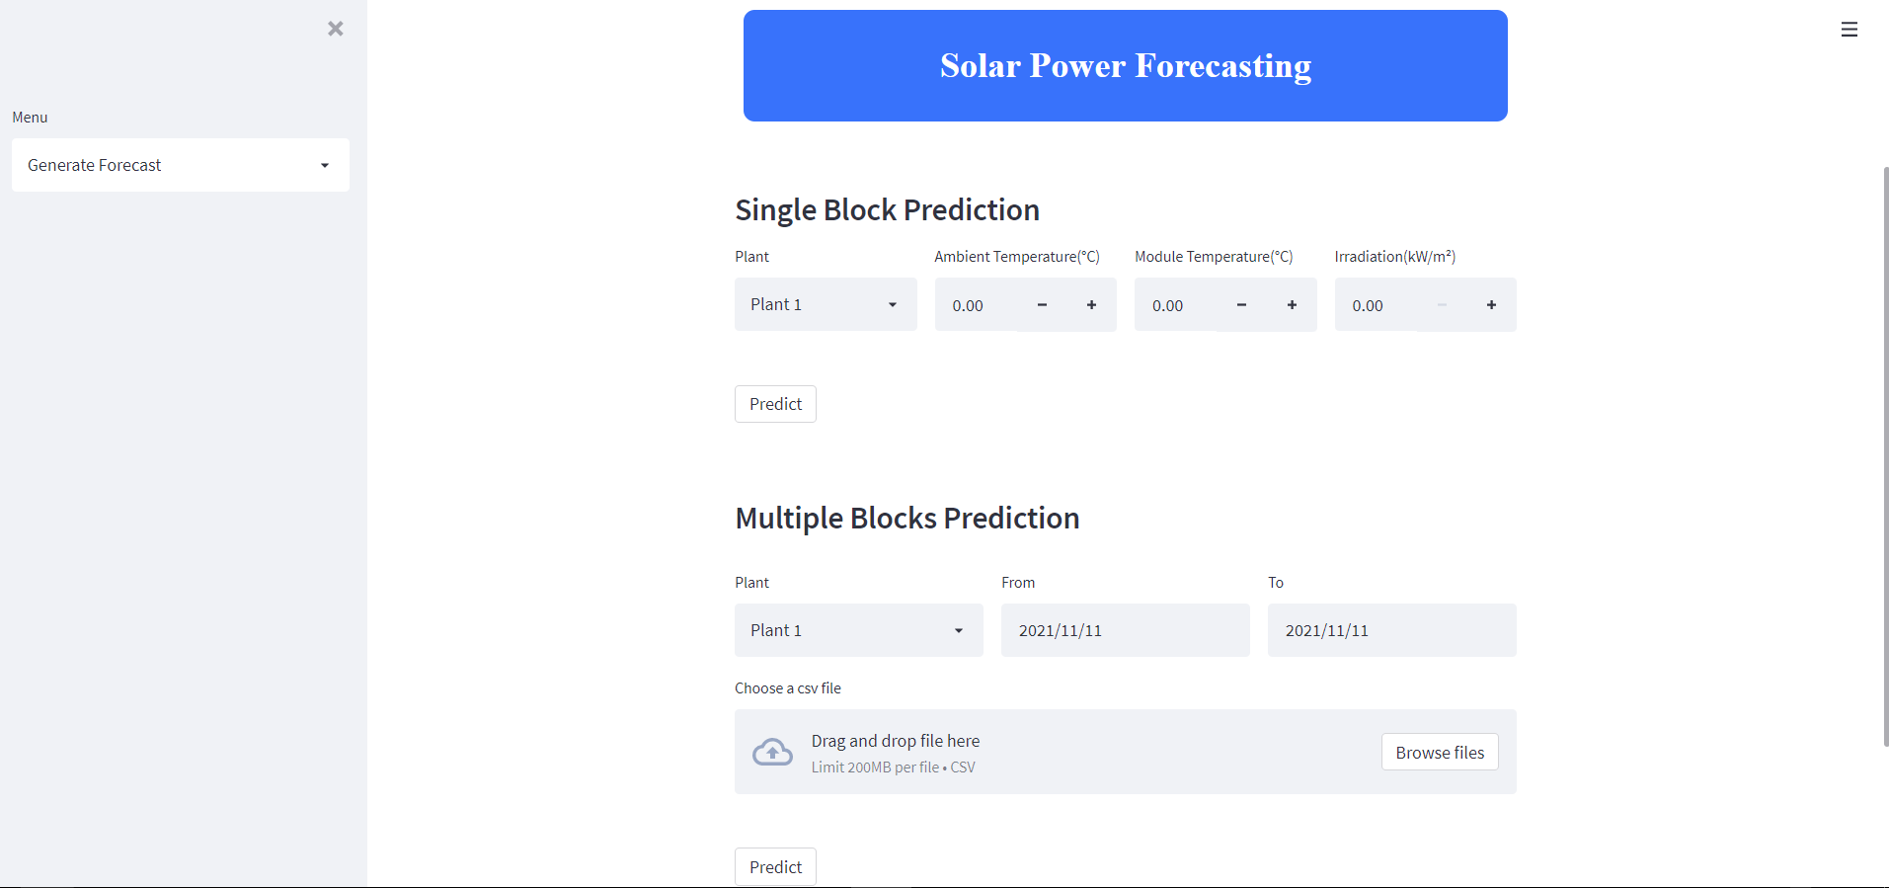
→ Now we deploy the model on localhost using the streamlit. → Streamlit is an open-source Python library that makes it easy to create and share beautiful, custom web apps for machine learning and data science. In just a few minutes you can build and deploy powerful data apps.
Deployment

Slide 21
→ The solar photovoltaic power forecasting depends upon the unpredictable parameters of weather as well as the intrinsic parameters of solar PV systems themselves such as the temperature of PV modules and the irradiance on the plane of PV array. In this project, the study of the forecasting parameters included Ambient Temperature , Module Temperature and Irradiation which are the static parameters for the forecasting . → Among the various model tested, the best model found for training and testing was Random Forest Regressor model . Further Hyperparameter Tunning helped in selecting the best parameters for model training and test providing better accuracy than before which is more skilful methods and approaches in this area alongside the generalization methods that are capable to generalize the forecasting results.
conclusion

Slide 22
→ In future a solar power forecasting modelling may be developed using Natural inspired algorithm and compare with conventional forecasting techniques. The present work will help in forecasting of power generated by solar panels would reduce the charges. The accurate forecasting system solar power plant operation, controlling, maintenance planning and power estimation could be improved. → Nevertheless, there is still much work to be done in the area. For instance, a large, curated dataset would lead to increased accuracy in the predictions as well as foster investment in the area. Moreover, while we have focused on solar energy, the approach could be extended to other sustainable energies, such as wind-based energy production.

Slide 23
Thank You

